Slide 1
Results tommy

Slide 2
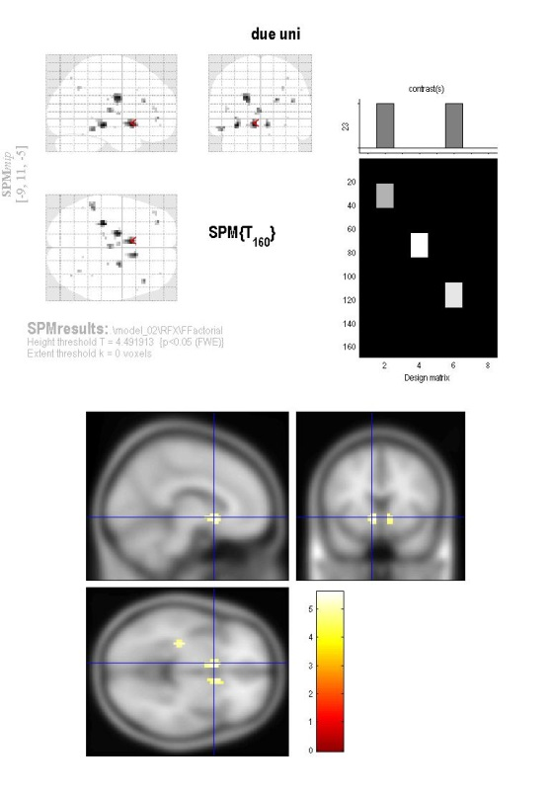
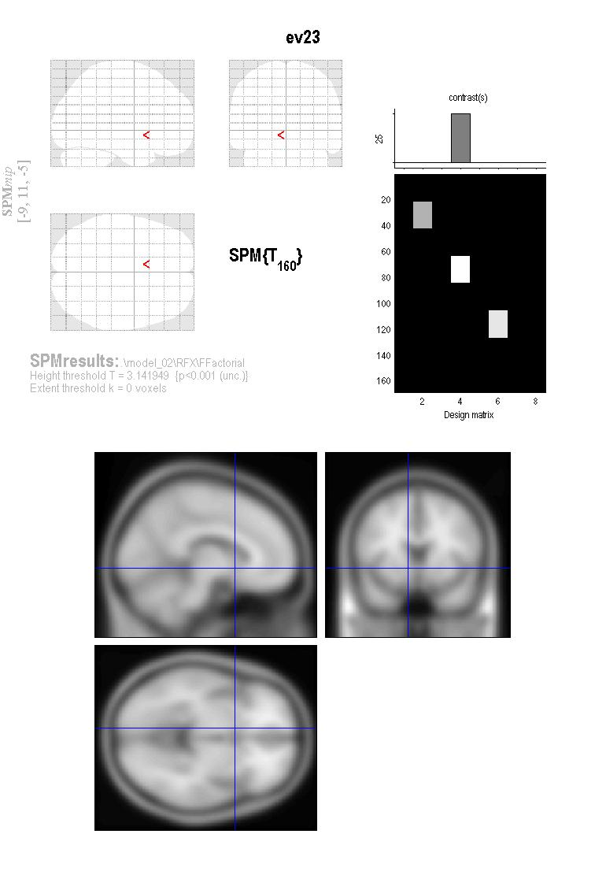
GAIN – LOSS
BOLD= eval1 +(gain-loss) + eval23 +(gain-loss) +evalRare +(gain-loss) +(decision1 decision2 decision 3 decision 123)+(eval2+eval3+outcome3+outcome123)
A:\DCJ\SPM\stat\tom\model_based\gain_loss\evaluation\dur_0\model_02\RFX\Ffactorial

Slide 3
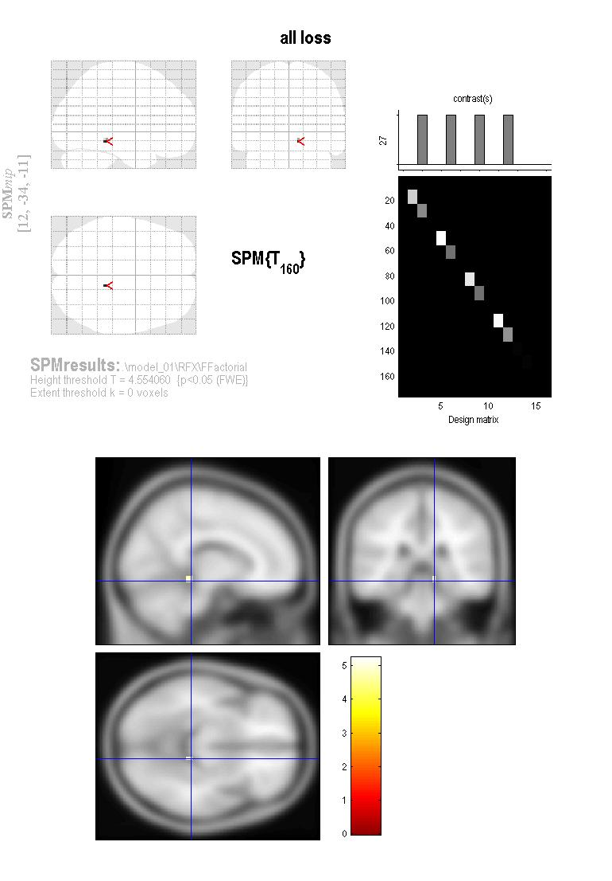
GAIN & LOSS
BOLD= eval1 +(gain & -loss) + eval23 +(gain&loss) +evalRare +(gain-loss) +(decision1 decision2 decision 3 decision 123)+(eval2+eval3+outcome3+outcome123)
A:\DCJ\SPM\stat\tom\model_based\condtional\specialsubj\gain_loss\evaluation\dur_1\model_01\RFX\FFactorial\
To FIX DURATION SUBJECTS CONDITIONAL

Slide 4

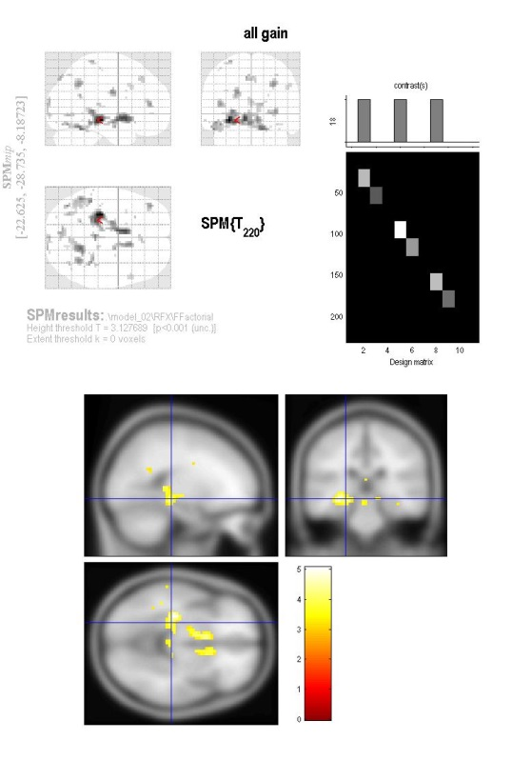
GAIN & LOSS fixed
BOLD= eval1 +(gain & -loss) + eval23 +(gain& -loss) +evalRare +(gain & -loss) +(decision1 decision2 decision 3 decision 123)+(eval2+eval3+outcome3+outcome123)
A:\DCJ\SPM\stat\tom\lastnight\model_based\gain&loss_giusto\evaluation\dur_0\model_02\RFX\FFactorial\
Screen 1= all gain (not all win) few 0.05 Screen2+ all gain p 0001 no fwe

Slide 5
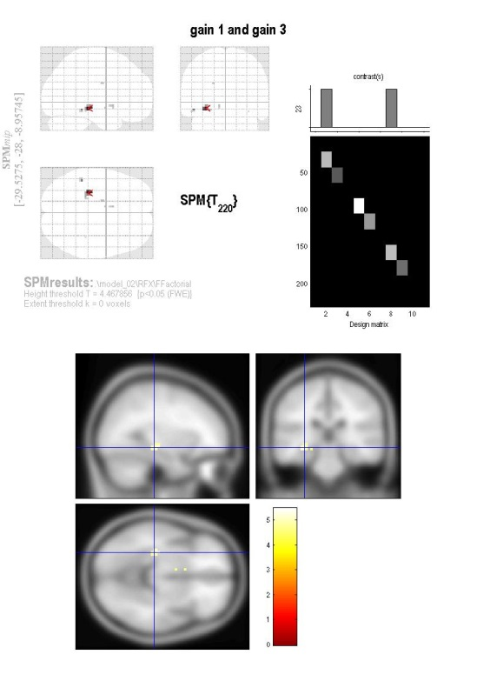
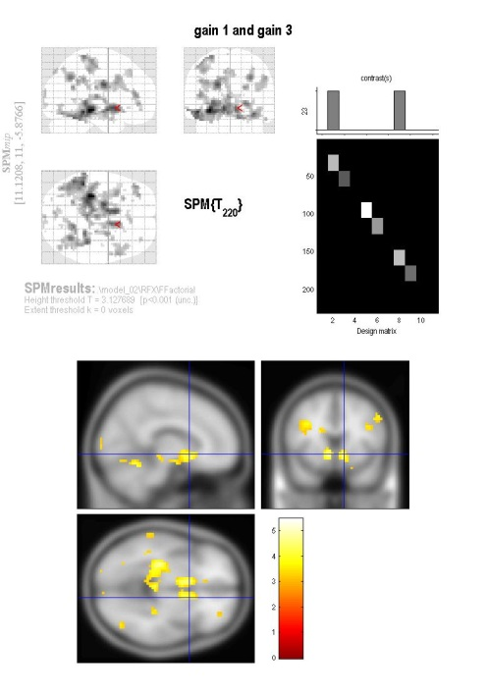
GAIN & LOSS fixed
BOLD= eval1 +(gain & -loss) + eval23 +(gain& -loss) +evalRare +(gain & -loss) +(decision1 decision2 decision 3 decision 123)+(eval2+eval3+outcome3+outcome123)
A:\DCJ\SPM\stat\tom\lastnight\model_based\gain&loss_giusto\evaluation\dur_0\model_02\RFX\FFactorial\
Gain 1 and Gain 3

Slide 6
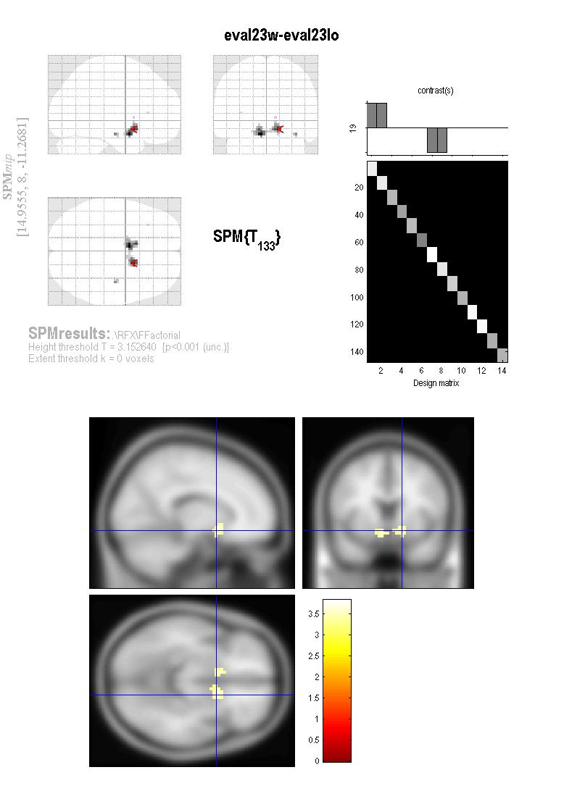
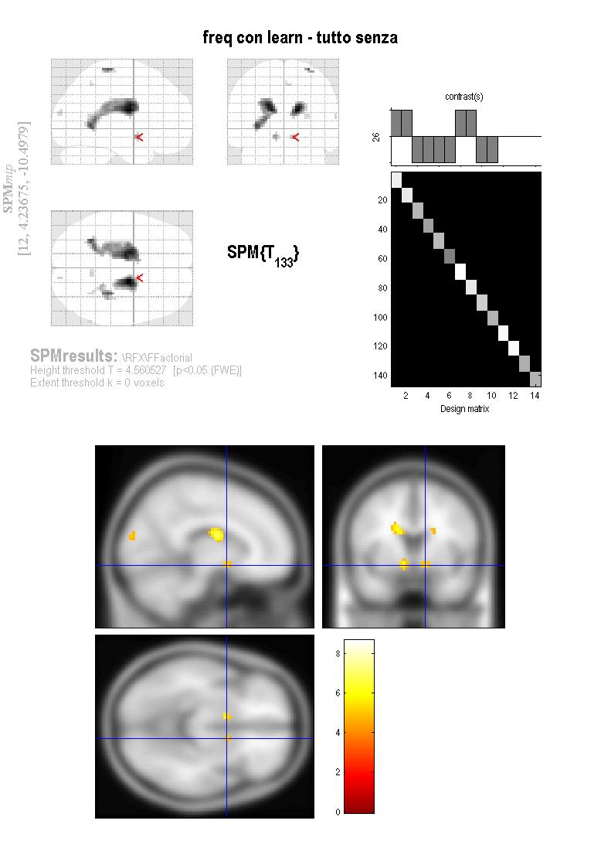
Outcome No parameters
A:\DCJ\SPM\stat\tom\model_based\condtional\specialsubj\2groups\outcome\noparam\dur_0\mincomplexity\RFX\Ffactorial

Slide 7
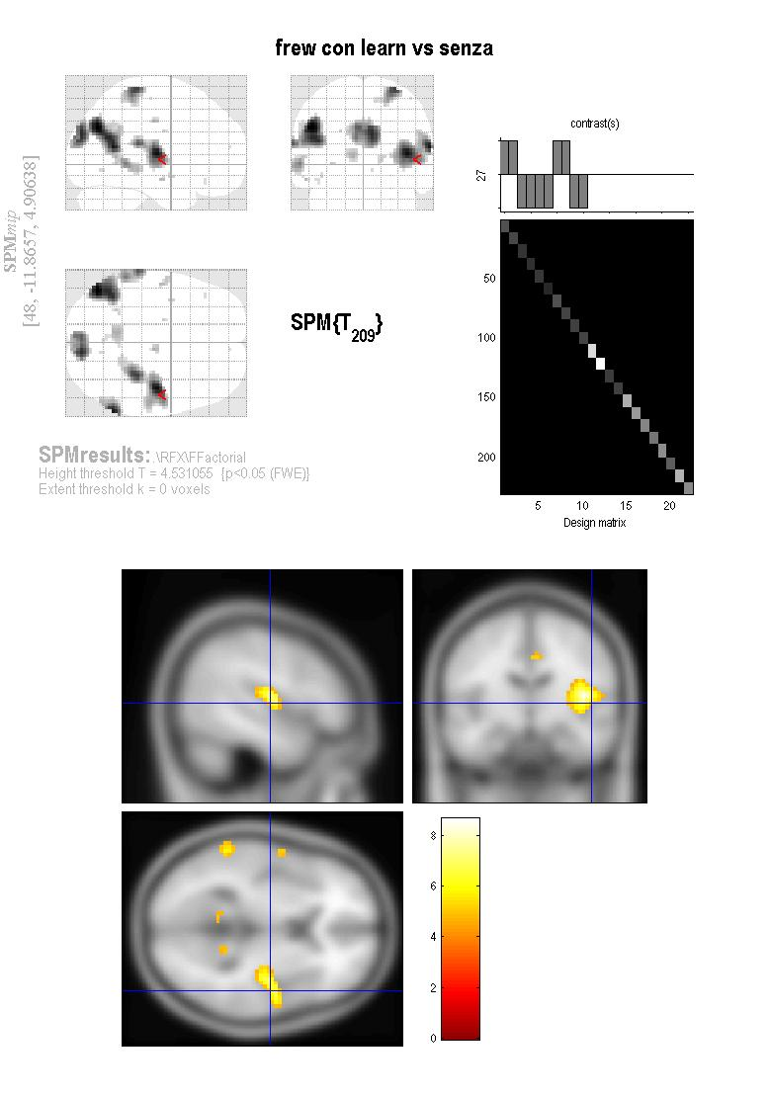
Outcome No parameters – 1s
A:\DCJ\SPM\stat\tom\model_based\condtional\specialsubj\2groups\outcome\noparam\dur_0\mincomplexity\RFX\Ffactorial

Slide 8
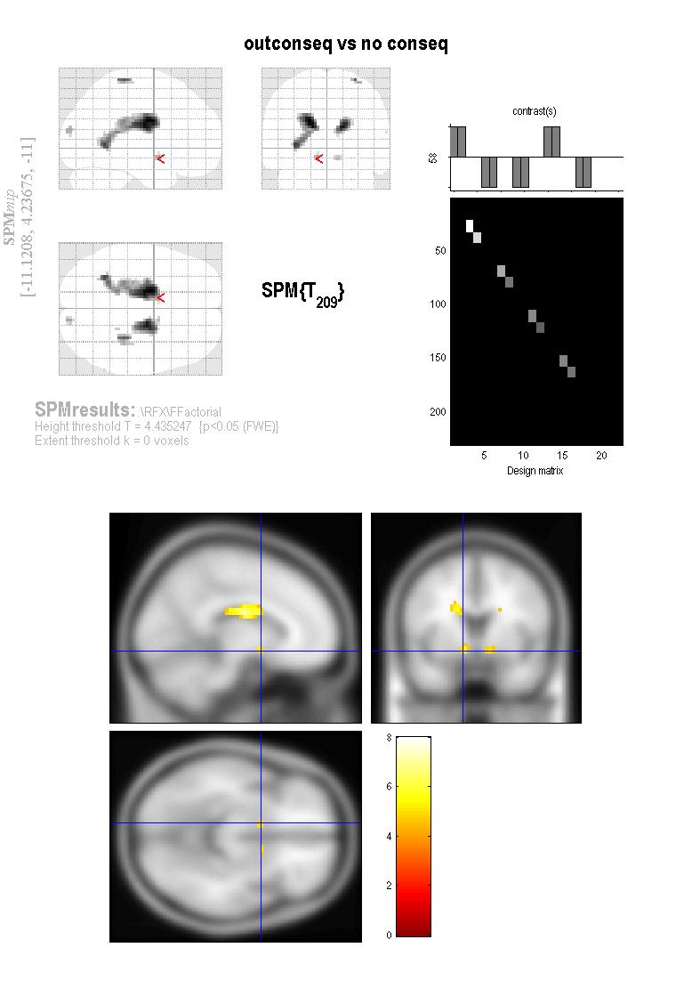


Outcome parameters
A:\DCJ\SPM\stat\tom\lastnight\model_based\condtional\specialsubj\2groups\outcome\taken\dur_0\mincomplexity\RFX\FFactorial

